Slide 1

JAVA STRINGS

Slide 2
Strings
It is a sequence of characters. Strings are immutable. In Java programming language, strings are treated as objects.
Two ways to create string object:
1.by string literal
2.by new keyword

Slide 3
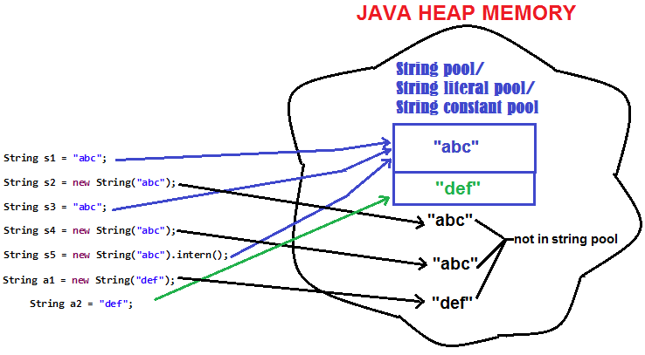
String storing procedure:

Slide 4
String functions:
1.char charAt(int index)
2.static string format(String format,object name)
3.string substring(int beginIndex)
4.string substring(int beginIndex,int endIndex)
5.boolean contains(charSequence s)
6.static String join(CharSequence delimiter, CharSequence elements)
7.boolean equals(Object another)
8. boolean isEmpty()

Slide 5
9.string concat(String str)
10.String replace(char old , char new)
11.String replace(charSequence old, charSequence new)
12.static String equalsIgnoreCase(String another)
13.String[] split(String regex)
14.String[] split(String regex, int limit)
15.String intern()

Slide 6
16.int indexOf(int ch)
17.int indexOf(int ch, int fromIndex)
18.int indexOf(String substring)
19.int indexOf(String substring, int fromIndex)
20.String toLowerCase()
21.String toUpperCase()
22.String trim()
23.static String valueOf(int value)
24. boolean contentEquals(String s)

Slide 7
25.static String copyValueOf(char[] data)
26.static String copyValueOf(char[] data, int offset, int count)
27. boolean endsWith(String suffix)
28. int hashCode()
29.boolean matches(String regex)
30.boolean regionMatches(boolean ignoreCase, int toffset, String other, int ooffset, int len)

Slide 8
31.boolean regionMatches(int toffset, String other, int ooffset, int len)
32.String replace(char oldChar, char newChar)
33.String replaceAll(String regex, String replacement)
34.String replaceFirst(String regex, String replacement)
35.Boolean startsWith(String prefix)
36. String toString()
37. char[] toCharArray()

Slide 9
String Buffer Class
Java string buffer class is used to create mutable(modifiable) string.
1.append(String s)
2.insert(int offset, String s)
3.replace(int startIndex, int endIndex, String str)
4.delete(int startIndex, int endIndex)
5.reverse()
6.capacity()

Slide 10
7.ensureCapacity(int minimumCapacity)
8.charAt(int index)
9.public intlength()
10.substring(int beginIndex)
11.substring(int beginIndex, int endIndex)

Slide 11
String Builder class
Java String Builder class is used to create mutable string
1.StringBuilder append(String s)
2.StringBuilder insert(int offset, String s)
3.StringBuilder replace(int startIndex, int endIndex, String str)
4.StringBuilder delete(int startIndex, int endIndex)
5.StringBuilder reverse()
6.int capacity()

Slide 12
7.void ensureCapacity(int minimumCapacity)
8.char charAt(int index)
9.int length()
10.String substring(int beginIndex)
11.String substring(int beginIndex, int endIndex)

